Slide 1
Crime in Chicago A Socioeconomic Exploration
Team Spicy Lime
Kanika Bhambi
Lazarus Goosby
Nick Hebert
Greg Rosen

Slide 2
Research Question
What is the relationship between socioeconomic factors
– such as income and education –
and crime in Chicago within the last five years?

Slide 3
Gathering the Data
City of Chicago Crime Dashboard
2013 - 2017
https://data.cityofchicago.org/Public-Safety/Crimes-2001-to-present-Dashboard/5cd6-ry5g
Point 2 Homes
2018
https://www.point2homes.com/US/Neighborhood/IL/Chicago.html

Slide 4
Grouping by Neighborhood
χ² test on arrests per capita in Chicago’s 77 neighborhoods
Null Hypothesis
Each neighborhood composed of similar populations
These populations produce the same number of crimes per capita as the city of Chicago
Critical Value
95% confidence with 76 degrees of freedom
97.35
χ² Statistic
Σ (Actual Crimes_{neighborhood} – Expected Crimes_{neighborhood})²
1,701,608.94
p-value
0.0
Conclusion
The neighborhoods are decidedly not composed of similar populations

Slide 5
ANALYSIS

Slide 6
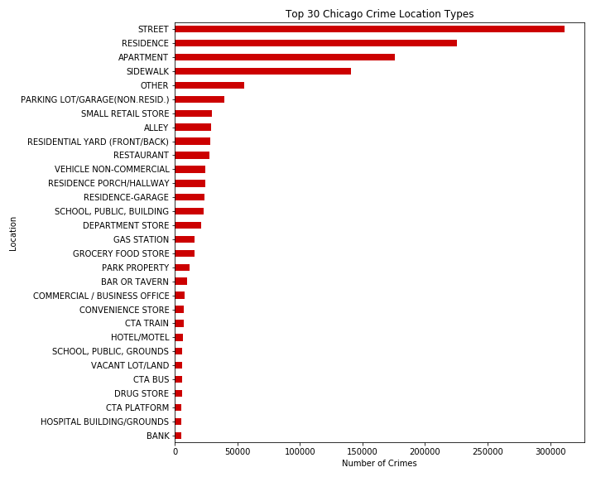
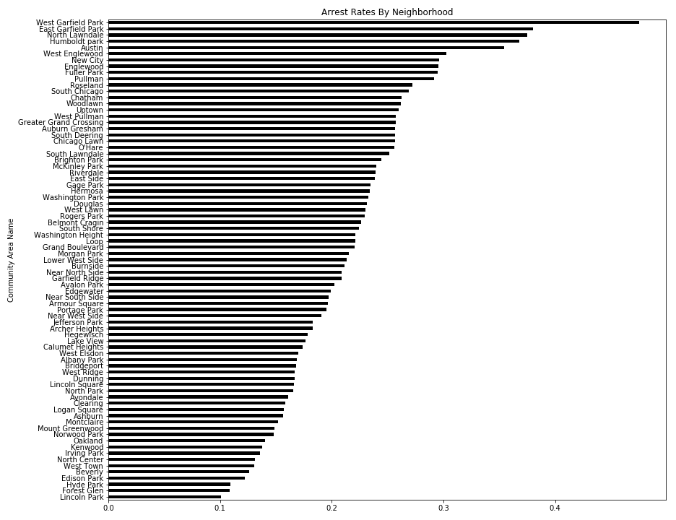
Crime By Location

Slide 7
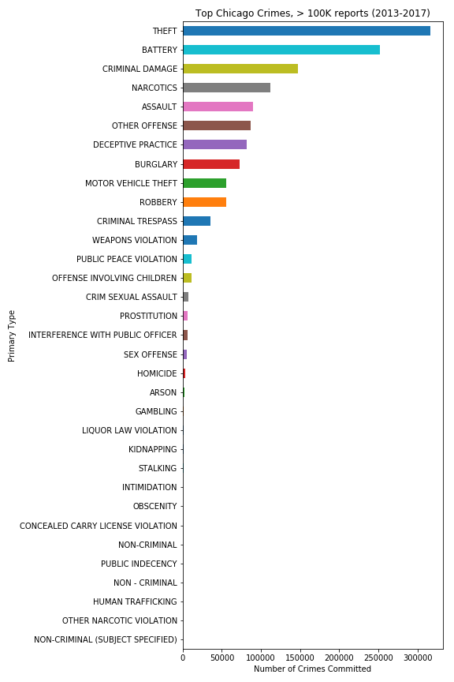
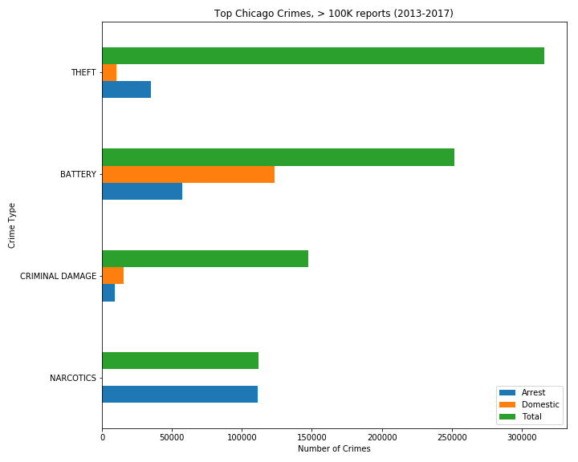
Crime by Type

Slide 8
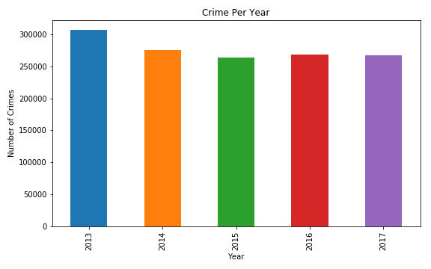
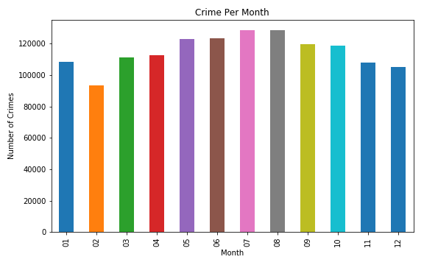
Crime Over Time

Slide 9
New Slide
Grouping 1
Grouping 2
Grouping 3

